Slide 1
Threaded Binary Tree

Slide 2
Defining Threaded Binary Trees
In a binary search tree, there are many nodes that have an empty left child or empty right child or both.
You can utilize these fields in such a way so that the empty left child of a node points to its inorder predecessor and empty right child of the node points to its inorder successor.
•

Slide 3
Threaded binary Tree
One way threading:- A thread will appear in a right field of a node and will point to the next node in the inorder traversal.
Two way threading:- A thread will also appear in the left field of a node and will point to the preceding node in the inorder traversal.
•

Slide 4







Defining Threaded Binary Trees
Consider the following binary search tree.
Most of the nodes in this tree hold a NULL value in their left or right child fields.
In this case, it would be good if these NULL fields are utilized for some other useful purpose.
. | 65 | .
. | 40 | .
. | 72 | .
 | 30
. | 50 | .
 | 69
 | 80
60

Slide 5


One Way Threaded Binary Trees
The empty left child field of a node can be used to point to its inorder predecessor.
Similarly, the empty right child field of a node can be used to point to its in-order successor.
Such a type of binary tree is known as a one way threaded binary tree.
A field that holds the address of its in-order successor is known as thread. In-order :- 30 40 50 60 65 69 72 80
. | 65 | .
. | 40 | .
. | 72 | .
30
 | 50 | .
69
 | 80
60

Slide 6


Two way Threaded Binary Trees
Such a type of binary tree is known as a threaded binary tree.
A field that holds the address of its inorder successor or predecessor is known as thread.
The empty left child field of a node can be used to point to its inorder predecessor.
Similarly, the empty right child field of a node can be used to point to its inorder successor.
Inorder :- 30 40 50 60 65 69 72 80
. | 65 | .
. | 40 | .
. | 72 | .
30
50
.
69
80
60

Slide 7
Node 30 does not have an inorder predecessor because it is the first node to be traversed in inorder sequence.
node 80 does not have an inorder successor.
. | 65 | .
. | 40 | .
. | 72 | .
30
50
.
69
80
60

Slide 8

Two way Threaded Binary Trees with header Node
The right child of the header node always points to itself.
Therefore, you take a dummy node called the header node.
Header Node
. | 65 | .
. | 40 | .
. | 72 | .
30
50
.
69
80
60

Slide 9

The threaded binary tree is represented as the left child of the header node.
Header Node
.
65
.
. | 40 | .
. | 72 | .
30
50
.
69
80
60

Slide 10

The left thread of node 30 and the right thread of node 80
point to the header node.
Header Node
.
65
.
. | 40 | .
. | 72 | .
.
50
.
69
.
30
80
60

Slide 11

Representing a Threaded Binary Tree
The structure of a node in a threaded binary tree is a bit different from that of a normal binary tree.
Unlike a normal binary tree, each node of a threaded binary tree contains two extra pieces of information, namely left thread and right thread.
The left and right thread fields of a node can have two values:
1: Indicates a normal link to the child node
0: Indicates a thread pointing to the inorder predecessor or inorder successor
 | 4631 | Information | 2389
Left Thread
Address of Left Child
Data
Address of Right Child
Right Thread

Slide 12
In a threaded binary tree, the right thread of a node points to its inorder , and the left thread points to its inorder .
Answer:
successor, predecessor

Slide 13
Threaded Binary Tree
Inorder traversal of a Binary tree done using recursion or with auxiliary stack.
Threaded binary trees makes inorder traversal faster - without stack and recursion.
A binary tree is made threaded by making all right child pointers point to the inorder successor of the node (if it exists).

Slide 14
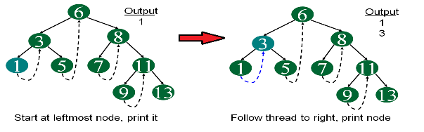
Inorder Order Traversal Using Threads
Step 1

Slide 15
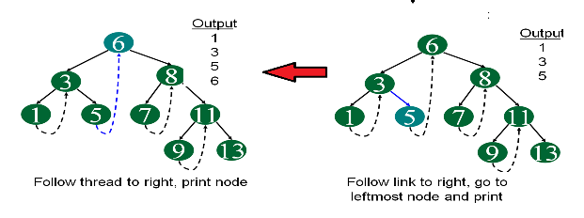
Inorder Order Traversal Using Threads
Step 2

Slide 16
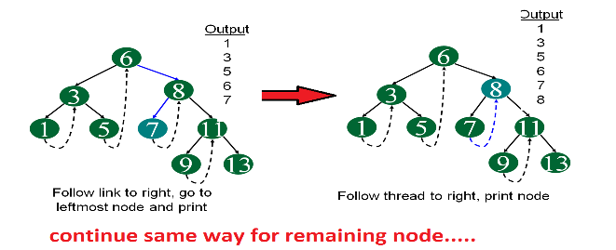
Inorder Order Traversal Using Threads
Step 3

